Slide 1
PROFESSIONAL ETHICS
LECTURE # 6

Slide 2

Stakeholder and issue management approaches to Ethics

Slide 3
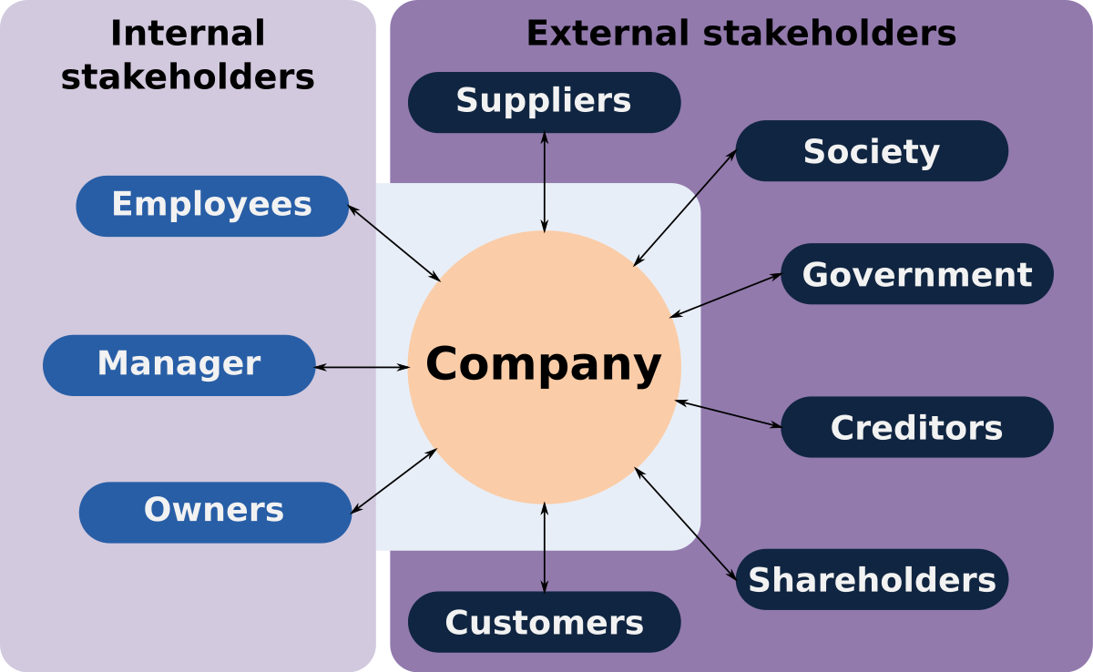
Stakeholders

Slide 4
Issue Management Approach
A problem that concerns both an organization and one or more of its stakeholders and/or shareholders.
A gap between organization actions and stakeholder expectations
An ethical long- term commitment by the organization to a two- way, inclusive standard of CSR toward stakeholders.
Issues managers help identify and close gaps between expectation, performance, communication, and accountability

Slide 5
Issue Management Approach
Issue management approaches involve proactive strategies aimed at identifying, addressing, and resolving ethical issues within organizations.
Promotes ethical behavior, prevents ethical lapses, and maintains trust with stakeholders.
Key aspects of issue management approaches :
Proactive Identification of Ethical Issues
Establishment of Ethical Codes and Policies
Stakeholder Engagement and Communication
Ethical Decision-Making Processes

Slide 6
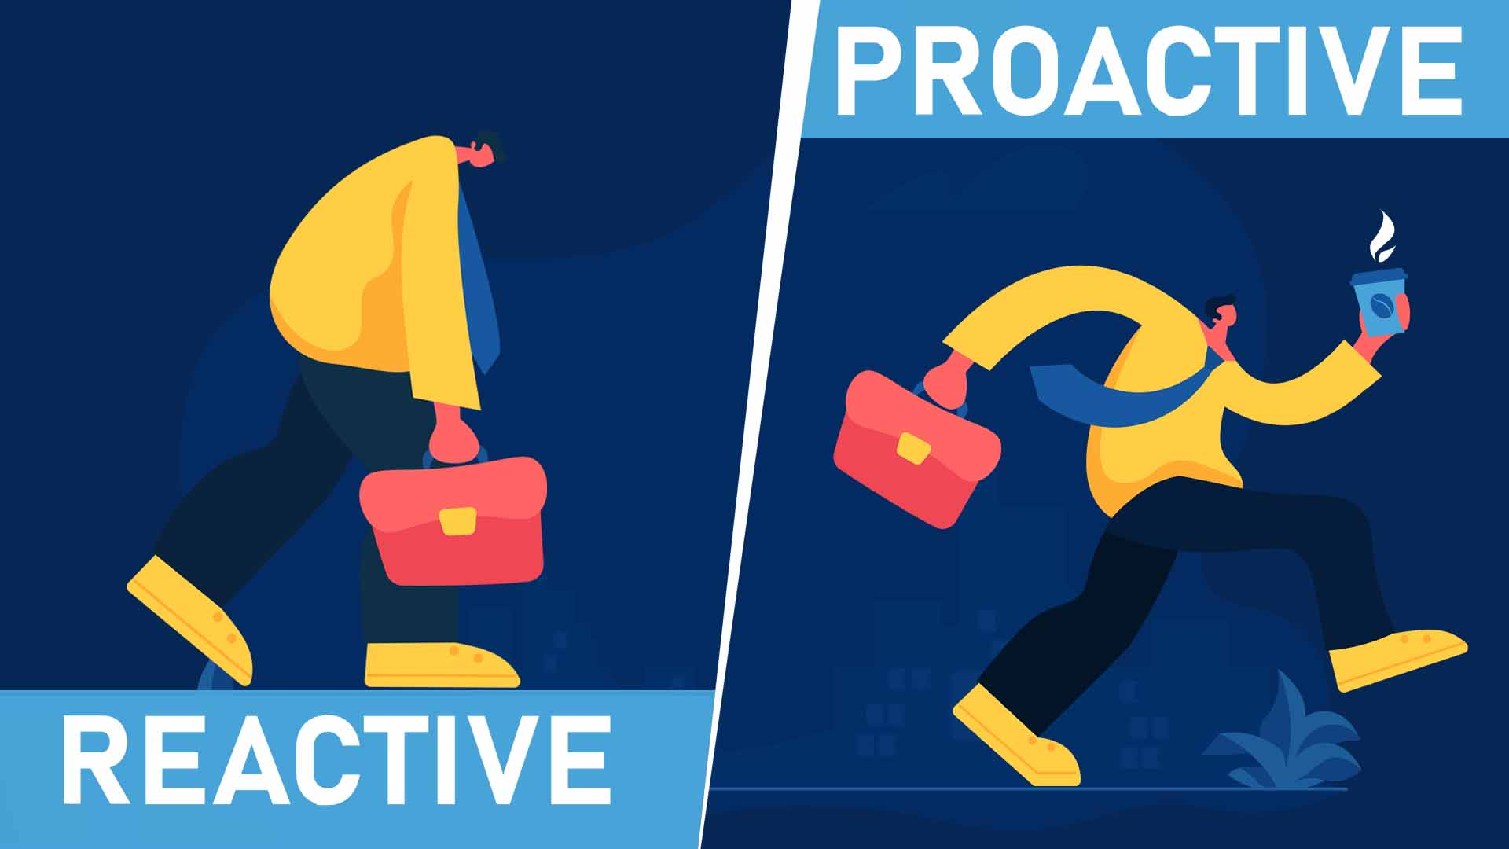
Proactive Identification of Ethical Issues
Rather than waiting for ethical issues to arise, organizations actively identify potential ethical concerns.
Through regular monitoring, risk assessments, and stakeholder engagement.
This proactive approach allows organizations to anticipate and address ethical challenges before they escalate into serious problems

Slide 7
Establishment of Ethical Codes and Policies
Organizations develop and implement ethical codes, standards, and policies
Outline expected behaviors, values, and principles for employees and stakeholders.
These guidelines serve as a framework for ethical decision-making and behavior, helping to prevent ethical breaches and guide actions in ambiguous situations.
Example : Explore and list down Ethical Codes and Policies of 3 examples (companies) from Pakistan ~Assignment

Slide 8
Stakeholder Engagement and Communication
Effective issue management involves engaging with stakeholders, including employees, customers, suppliers, investors, and the community
To understand their perspectives, concerns, and expectations regarding ethical issues.
Transparent communication fosters trust and collaboration, enabling organizations to address ethical challenges collaboratively and proactively.

Slide 9
Ethical Decision-Making Processes
Organizations establish clear processes and procedures for ethical decision-making, ensuring that employees have the necessary guidance and support to navigate ethical dilemmas effectively.
Ethical decision-making frameworks often involve considering the interests of stakeholders, evaluating the potential consequences of actions, and upholding core ethical principles.
Organizations hold individuals and groups accountable for ethical conduct by establishing mechanisms for reporting ethical concerns, investigating allegations of misconduct, and implementing appropriate disciplinary actions when necessary.

Slide 10
Ethical decision-making for cross-functional professionals
Professionals working across different functions or departments within an organization.
Cross-functional professionals often encounter complex situations where ethical considerations intersect with their responsibilities and interactions with diverse stakeholders.
Ethical decision-making ensures that professionals navigate these situations with integrity, accountability, and respect for ethical principles, thereby upholding the organization's values and reputation.

Slide 11
Case Study-Balancing Profitability and Social Responsibility
Scenario: ABC Corporation is a multinational manufacturing company known for producing consumer electronics. The company is considering expanding its operations to a developing country where labor costs are lower. However, the country has a history of labor rights violations and poor working conditions in manufacturing facilities.
ABC Corporation's cross-functional team, consisting of executives from finance, operations, human resources, and marketing departments, is tasked with making a decision regarding the expansion. The finance department projects significant cost savings and increased profitability by relocating manufacturing operations to the new country. However, the operations and human resources departments raise concerns about the ethical implications of operating in a region with documented labor rights abuses.

Slide 12
Case Study-Balancing Profitability and Social Responsibility
Should ABC Corporation prioritize profitability and cost savings by relocating manufacturing operations to a country with lower labor standards, or should it prioritize social responsibility and ethical conduct by avoiding business operations in regions with a history of labor rights violations?

Slide 13
Moral Responsibilities of Cross-Functional Area Professionals
Individual Decision Making : Focuses on the moral framework guiding individual decision-making within cross-functional roles.
Examples of ethical dilemmas faced by cross-functional professionals may include conflicts of interest, confidentiality breaches, or decisions impacting employee welfare and organizational reputation.
Stakeholder Perspectives and Considerations : It emphasizes the need for professionals to consider stakeholders' concerns, preferences, and expectations when making decisions.
Stakeholders can influence decision-making processes and outcomes through their input, feedback, and influence.

Slide 14
Managing Crisis and conflict resolution/ risk management

Slide 15
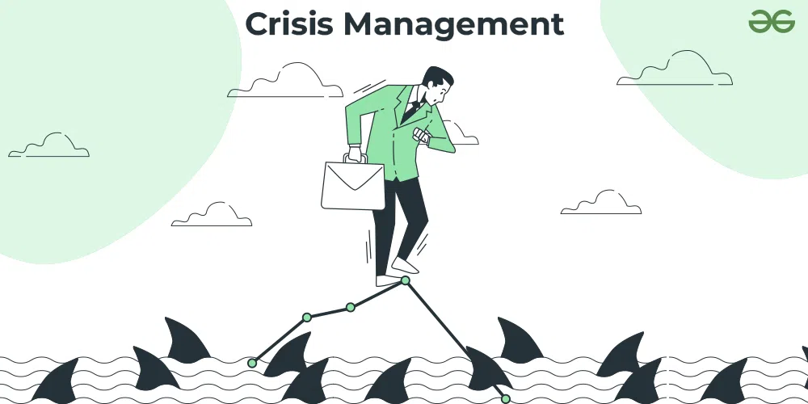

Slide 16
Crisis management
Crisis management refers to the process of effectively handling and mitigating the impact of unexpected events or emergencies that have the potential to disrupt normal operations, harm stakeholders, or damage an organization's reputation. It involves a systematic approach to identifying, assessing, responding to, and recovering from crises in a timely and strategic manner

Slide 17
Managing Crisis
“Turning point for better or worse,” a “decisive moment” or “crucial time”
The art of removing much of the risk and uncertainty to achieve more control over the situation
Crisis management methods evolved from the study of how corporations and leaders responded (and should have responded) to crisis
Essential for understanding and possibly preventing future fiascos.

Slide 18
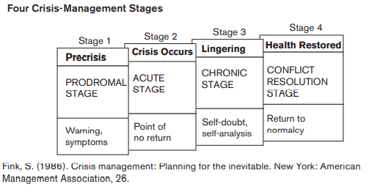
Stages of Crisis Management
Notes:
The conflict resolution stage pertains specifically to situations involving interpersonal or organizational conflicts. It involves identifying, addressing, and resolving conflicts through collaborative problem-solving, negotiation, mediation, or other conflict resolution techniques. This stage focuses on restoring harmony, understanding, and cooperation among conflicting parties to achieve mutually acceptable solutions and prevent future conflicts.

Slide 19
1. Prodromal Stage (Warning Stage)
Early signs or signals of a potential crisis appear.
Organizations can still prevent or minimize the impact if they act quickly.
Example: A company notices declining customer satisfaction or safety complaints.
Goal: Detect and prevent the crisis.

Slide 20
Acute Stage (Crisis Occurs)
The crisis hits—damage begins to occur.
Decisions made at this point are critical and time-sensitive.
Communication, quick action, and leadership are essential.
Goal: Contain the crisis and protect stakeholders.

Slide 21
Chronic Stage (Ongoing Impact)
The organization deals with the long-term effects.
There may be investigations, media attention, financial losses, or internal reforms.
Goal: Repair reputation, rebuild trust, and implement corrective actions.

Slide 22
Conflict Resolution (Recovery and Learning)
The organization fully recovers and learns from the event.
Policies, training, and systems are updated to prevent recurrence.
Goal: Turn the crisis into an opportunity for growth and resilience.

Slide 23
Conflict / Dispute Resolution Techniques
Relational Approaches
Integrative Approaches
Distributive Approaches
Problems
Resources-expand the pie
Value creating
Interests of each of the parties
Negotiation-Collaboration
Win– win or “all gain”
Power, interests, rights, and ethics
Relationship building
Narrative,
Deliberative, and other “dialogical
Restorative justice and reconciliation
Problems
Resources-divide the pie
Value claiming
Splitting the difference
one party's gain is another party's loss
compromise and arbitration
Notes:
Integrative approaches to conflict resolution focus on finding solutions that maximize mutual gains and create value for all parties involved.
Distributive approaches to conflict resolution involve dividing a fixed set of resources between conflicting parties. These techniques often result in zero-sum outcomes, where one party's gain is another party's loss
Relational approaches to conflict resolution focus on preserving and improving relationships between conflicting parties while addressing the underlying issues causing the conflict. These techniques prioritize communication, empathy, and understanding to repair trust and strengthen connections.

Slide 24
Conflict Resolution Techniques (Behavioral Methods)
Avoidance (Withdrawing)The person or organization avoids dealing with the conflict directly. Useful when the issue is minor or when emotions are too high. Risk: Problem may worsen if ignored too long.
Example: Postponing a meeting until emotions settle.
Accommodation (Smoothing)One side gives in to maintain harmony. Used when preserving the relationship is more important than winning. Risk: Can cause resentment if repeated often.
Example: A manager accepts a team member’s proposal to keep peace.

Slide 25
Compromise (Sharing)Each side gives up something to reach a middle ground. Fast and practical, but no one gets exactly what they want.
Example: Two departments split a limited budget equally.
Competition (Forcing)One side asserts power or authority to achieve its goals. Useful in emergencies when quick decisions are needed. Risk: Can damage trust or morale if overused.
Example: Management enforces a policy change during a crisis.

Slide 26
Collaboration (Problem-Solving)Both sides work together to find a win–win solution. Focuses on understanding needs, not just positions. Best for: Long-term relationships, complex issues, or crises needing creative solutions.
Example: A cross-functional team jointly designs a new crisis response plan.

Slide 27
Strategies (Formal or Procedural Mechanisms)
These are structured processes or systems for managing disputes, especially in organizations, legal, or inter-organizational settings.
Negotiation – Direct discussion between parties.
Mediation – Neutral third party facilitates communication.
Arbitration – Third party gives a binding decision.
Litigation – Legal action in court.
Conciliation – Informal third-party assistance before mediation
Strategies are formal ways to settle disputes at organizational or legal level.

